Slide 1
Artist & song popularity
IST687 Final Project
By: Courtney Smith, Jeremy Wallner, John Fields, Juan Castro

Slide 2

Notes:
There are several TV shows that seek to predict the next big hit in music. We wanted to predict the popularity of artist and songs based on the data of the song (may want to put a different term) itself

Slide 3

OVERVIEW
The purpose of this project is to analyze the Million Song Database to predict "Hot-Warm-Cold" artists and songs based on attributes such as familiarity, artist location, loudness, terms used, and other variables.
The analysis was done using R software on a 10,000 track subset of the data and our model was able to predict ratings of "Hot-Warm-Cold“ for artists with ~80% accuracy and songs with ~50% accuracy.
Notes:
What? Why? Where?

Slide 4

data

Slide 5
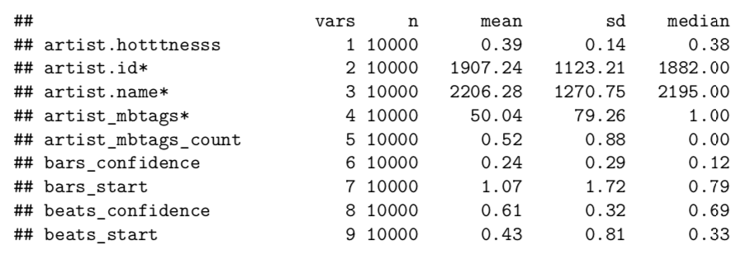
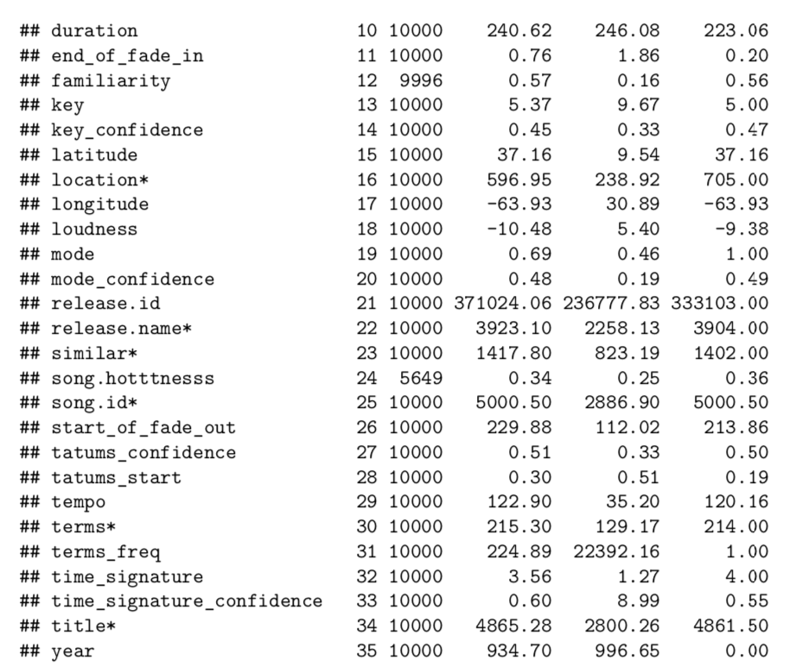
Data
Song Dataset
As the original Million Song Dataset (MSD) is incredibly large (~280GB), we based this analysis on a subset of 10,000 songs (1.8GB) for ease of data parsing, manipulation and modeling. The dataset was downloaded from CORGIS.
Artist Dataset
The dataset contains 36 variables and 9,996 observations. The table below identifies the various fields and provides a description for each as defined by millionsongdataset.com.
Notes:
Lets brake down why we use the variable that we used for each data set

Slide 6

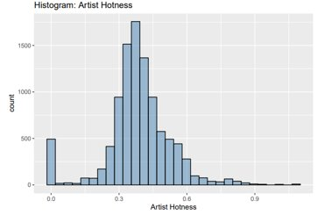
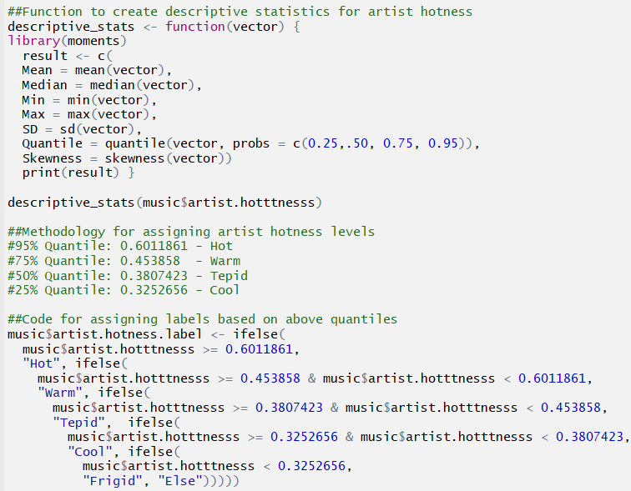
MILLION SONGS DATASET: PREDICTING SONG/TRACK POPULARITY
Goals:
To Predict: whether an artist or song will be "popular" or not
To Answer: What factors make an artist/song "popular"?
Categorical labels: 3 or 5 levels of popularity
Notes:
Courtney

Slide 7
Methodology
Assign Categorical Artist & Song Popularity Levels:
3 Levels
Hot (>.4590)
Warm (<.4590 and >.3357)
Cold (<.3357)
5 Levels
Hot: >95% Percentile (~0.6012)
Warm: >75% Percentile (~0.4539)
Tepid: >50% Percentile (~0.3807)
Cool: >25% Percentile (~0.3253)
Frigid: <25% Percentile (~0.3253)
Utilized two models to predict artist/song popularity:
Linear Regression
Random Forest
Results:
Best Variables for Predicting Popularity:
Artists – Familiarity
Songs – Loudness
Model | Dataset | Accuracy (%)
Linear | Artist | 64% (R²)
RandomForest | Artist | 80%
Linear | Song | 6% (R²)
RandomForest | Song | 48%
Notes:
Courtney

Slide 8
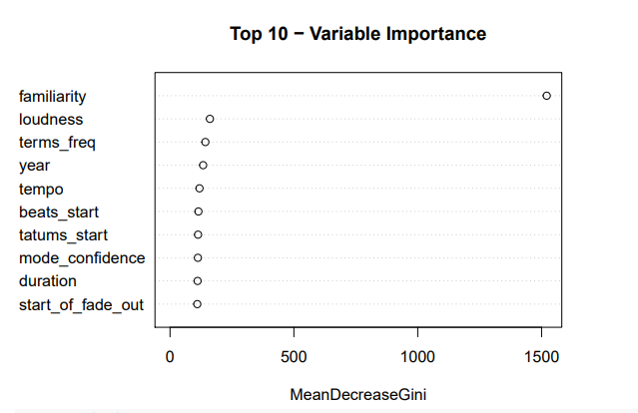
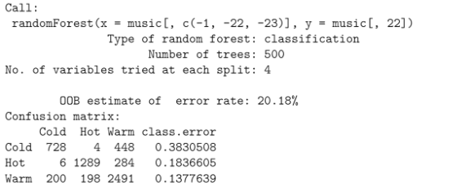
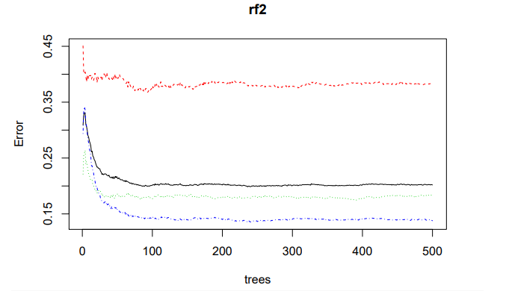
METHODS
Random Forest – Artist Popularity
Notes:
We can add more notes about this or add additional slides to go deeper into the random forest aspect of it

Slide 9
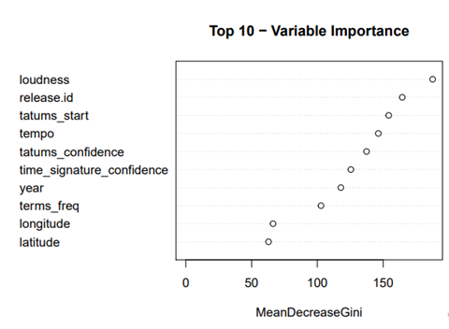
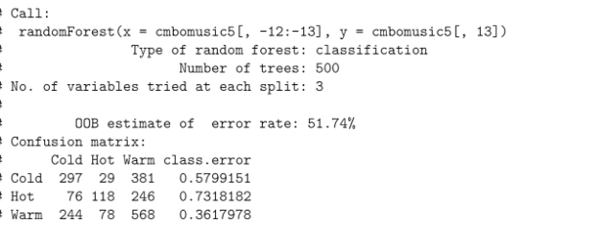
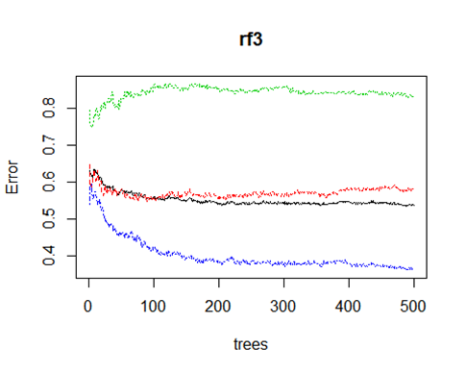
METHODS
Random Forest - Song Popularity
Notes:
The Random Forest was run with the default of 500 trees. The graph shows that the number of trees before the error levels out is about 200 trees.

Slide 10
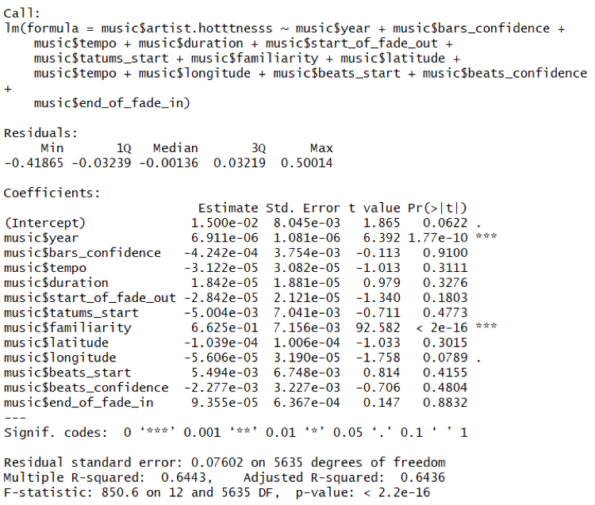
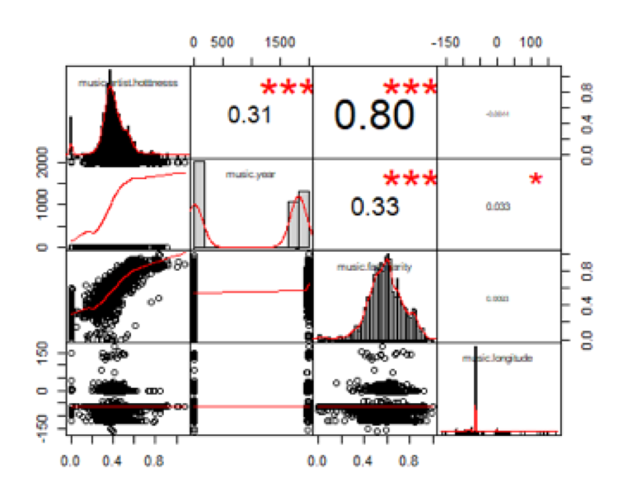
Methods
Regression and Correlation
Notes:
For the initial linear artist-hotness regression, a model with all the variables was ran; this gave us insignificant P-values all around. We started taking out the ones that seemed to have too high of a P-value, and ended with a simpler model of 3 variables; year, familiarity and longitude. Longitude had a negative effect on the hotness, (with a not so significant P-value), as the longitude increased, the hotness of the artist would be smaller. The linear regression gave us an adjusted R-squared of .64, not ideal but higher than expected with such few variables that were significant.

Slide 11

Lessons learned

Slide 12

Lessons learned
Data Munging really does take 70-80% of the time for a project!
N/A and Zero variables will cause more problems if not handled appropriately
As the longitude increased, the hotness of the artist would be smaller
A data that has relative song popularity per year may be more dependable when using year to predict the popularity
Commenting your code is incredibly important!
Notes:
Courtney

Slide 13
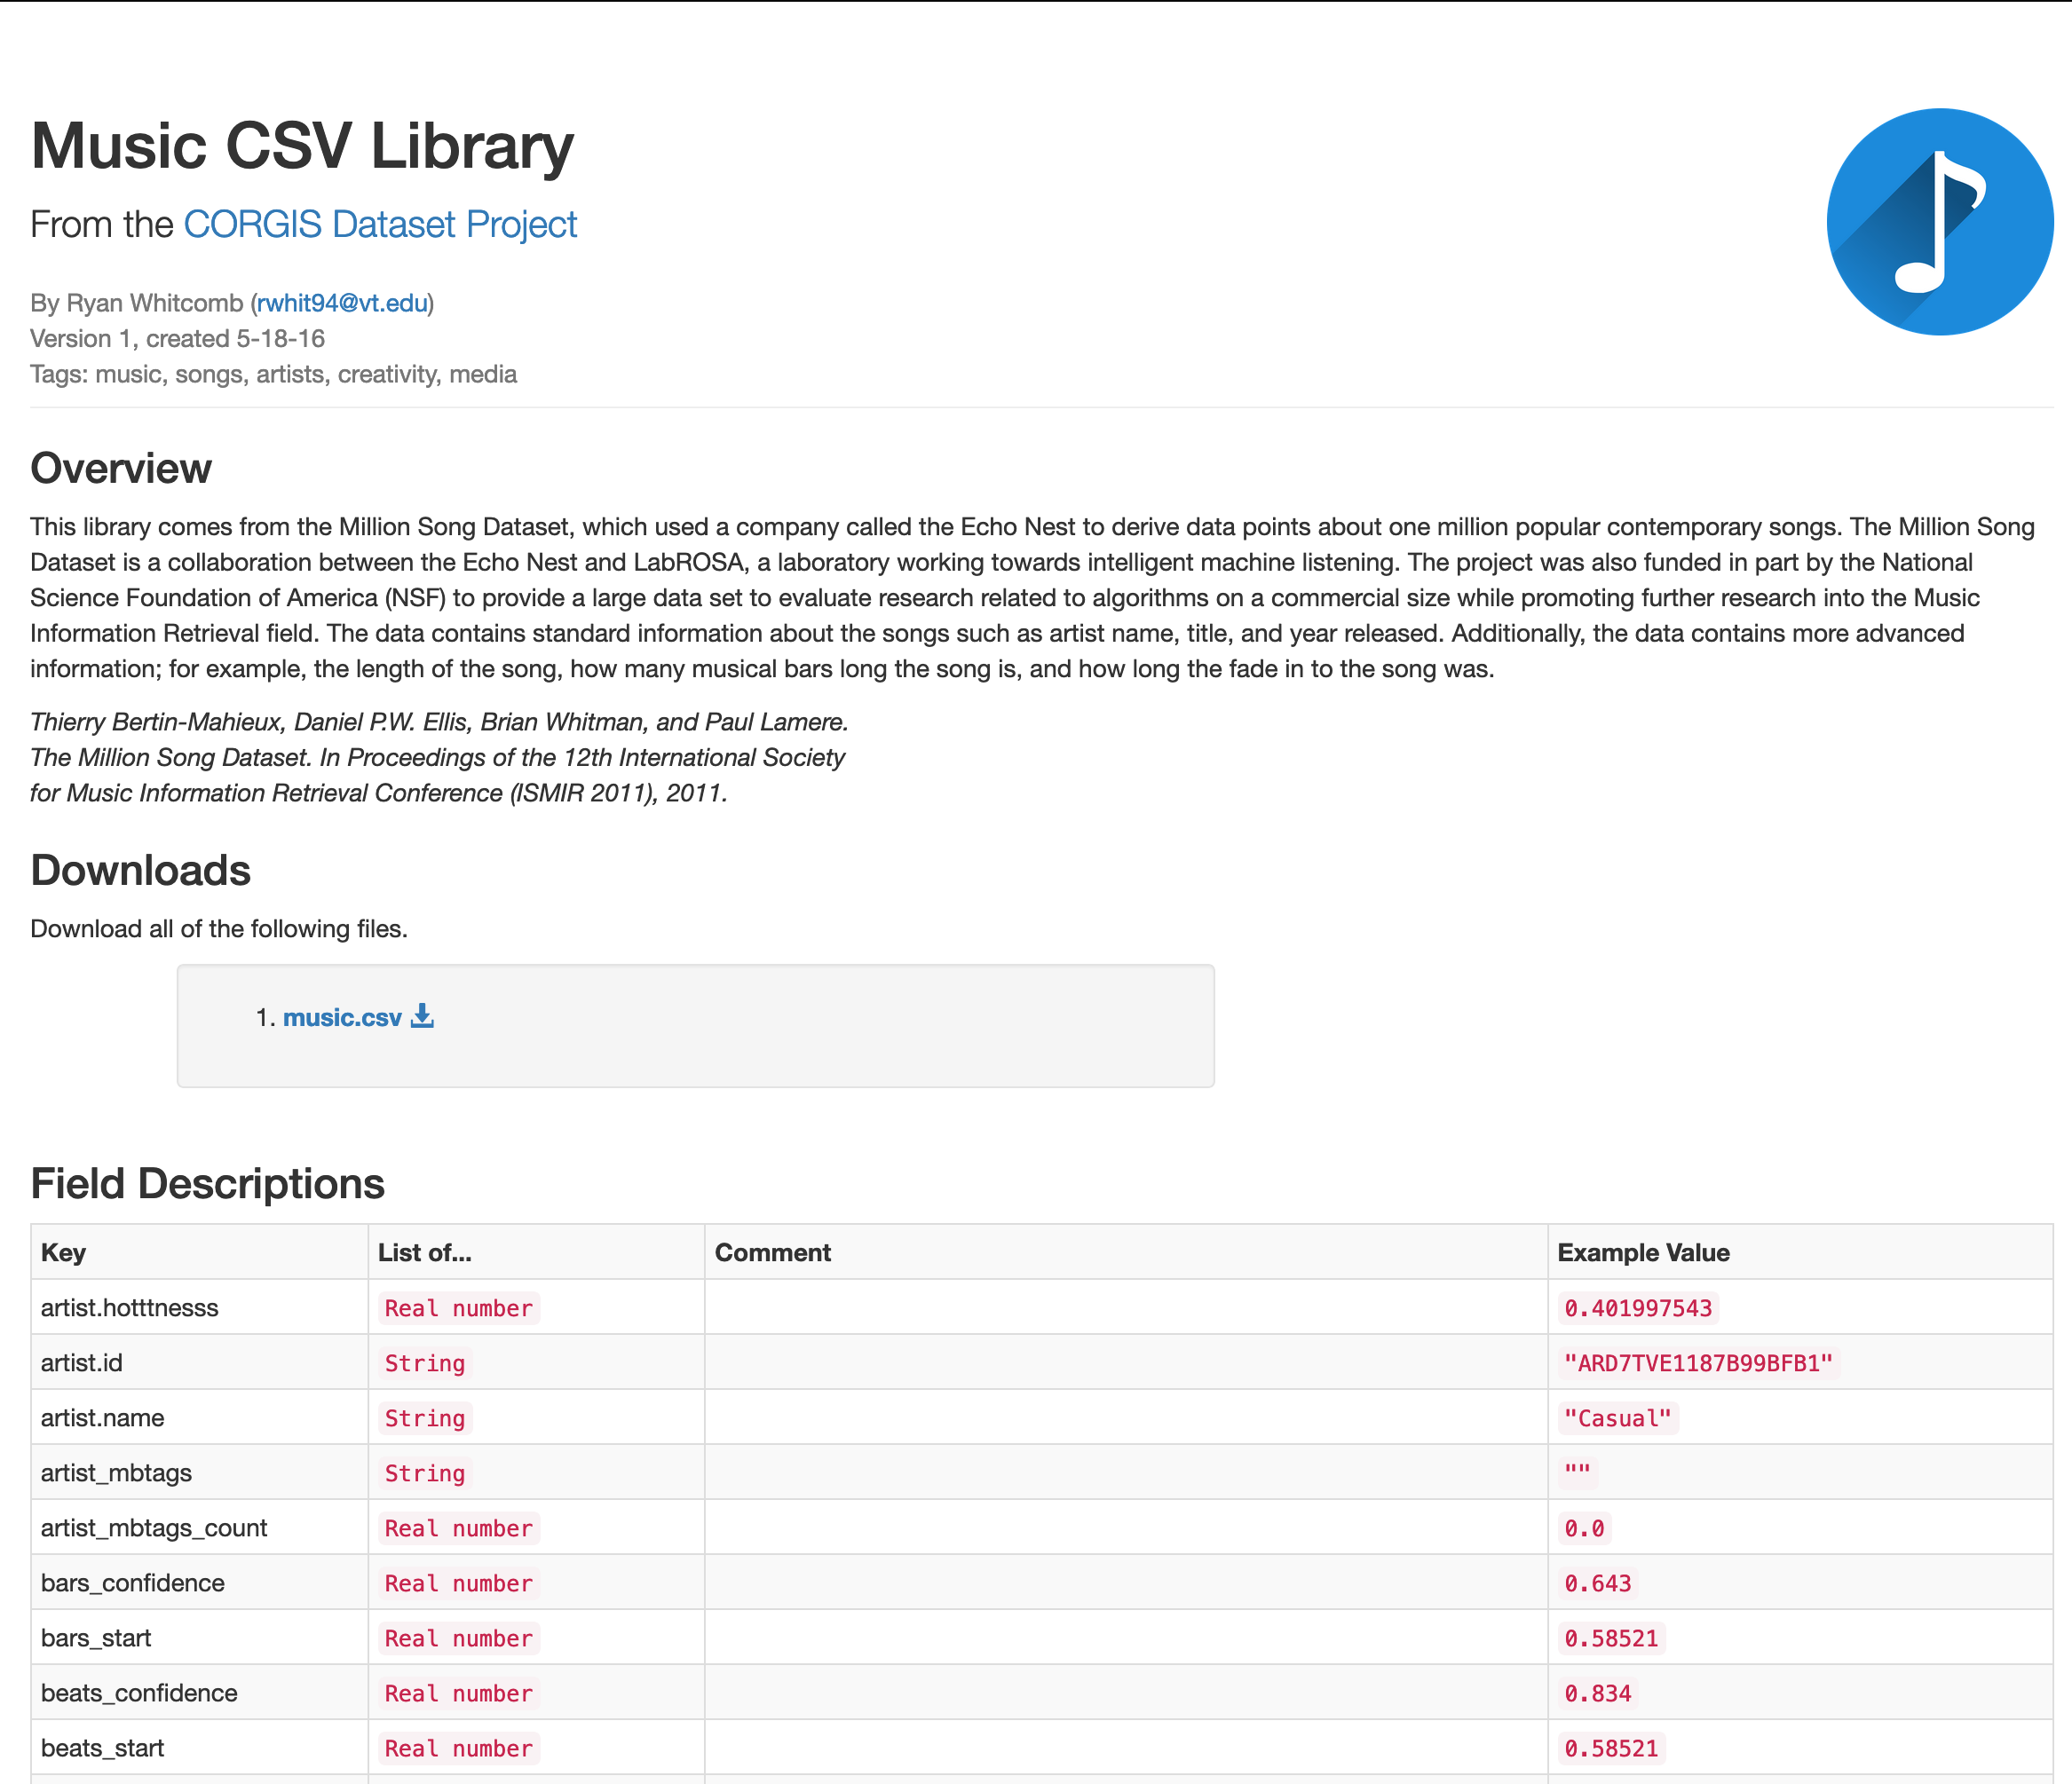
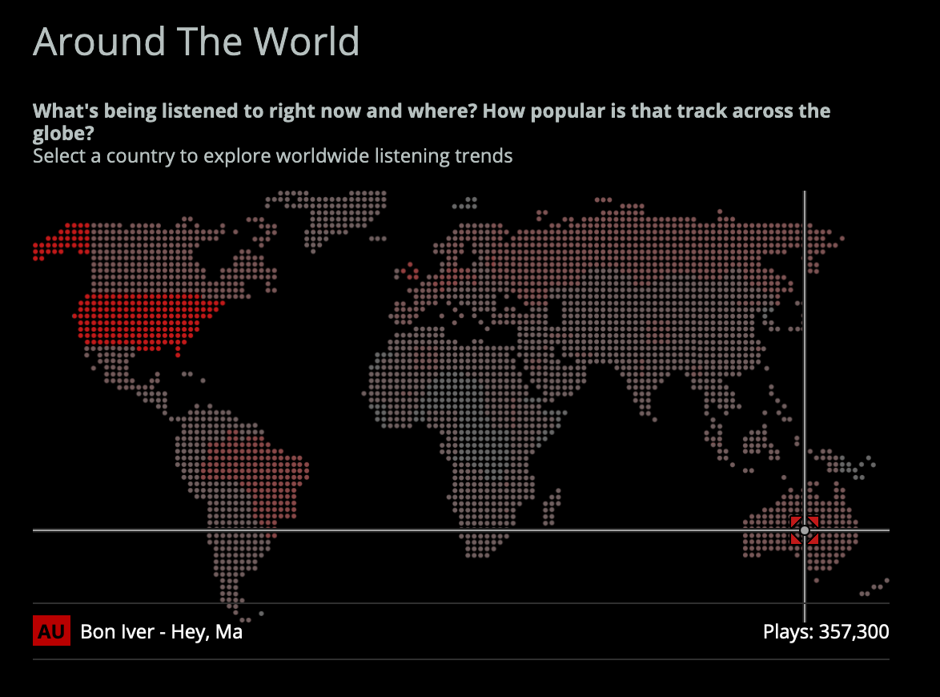
references
Virginia Tech - https://think.cs.vt.edu/corgis/csv/music/music.html
Thierry Bertin-Mahieux, Daniel P.W. Ellis, Brian Whitman, and Paul Lamere. The Million Song Dataset. In Proceedings of the 12th International Society for Music Information Retrieval Conference (ISMIR 2011), 2011.
https://www.last.fm/api
The Last.fm API allows anyone to build their own programs using Last.fm data
Notes:
John

Slide 14
Recommended music
John – Claire Ernst, John The Blind, Maggie Rogers, Tom Misch, Tyler Childers
Juan – Sia, Bob Dylan, Shakira, Carlos Vives, Merengue(for dancing)
Courtney – Old Dominion, Dierks Bentley, Chase Rice, Brothers Osborne
Jeremy – Dierks Bentley, Ed Sheeran, Fall Out Boy, Eminem, Cary Brothers
Note: No algorithms were harmed in the development of this list. This is simply music we like. Enjoy!

Slide 15

Notes:
End mark

Slide 16

appendix

Slide 17
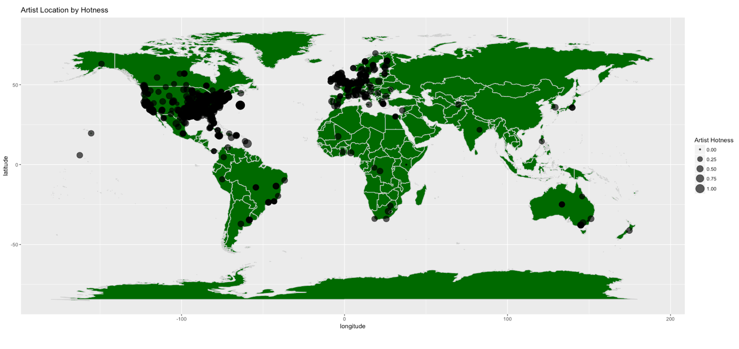
ARTIST LOCATION AND HOTNESS

Slide 18
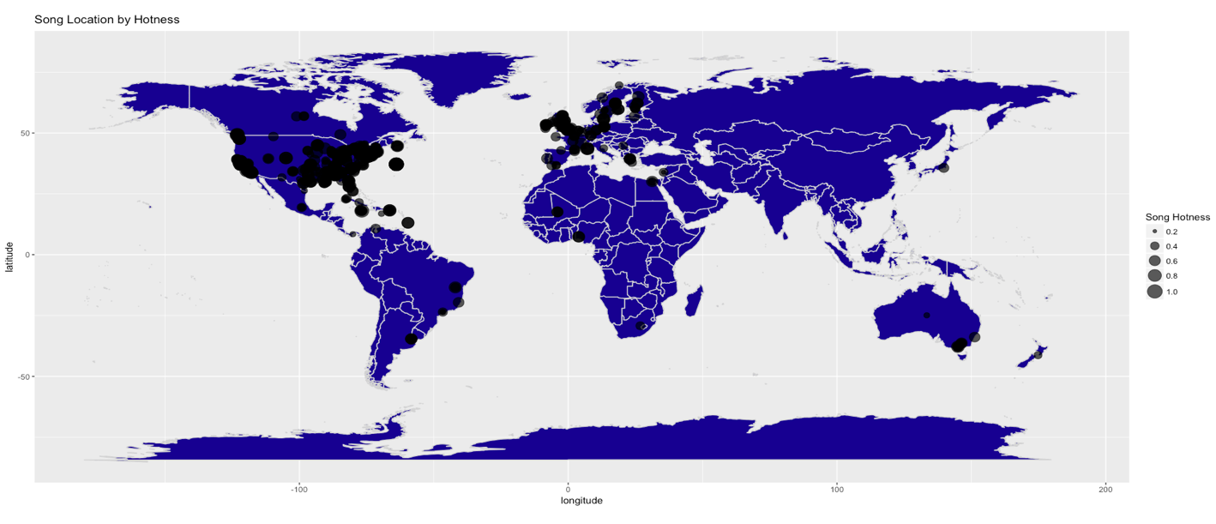
Song LOCATION AND HOTNESS

Slide 19
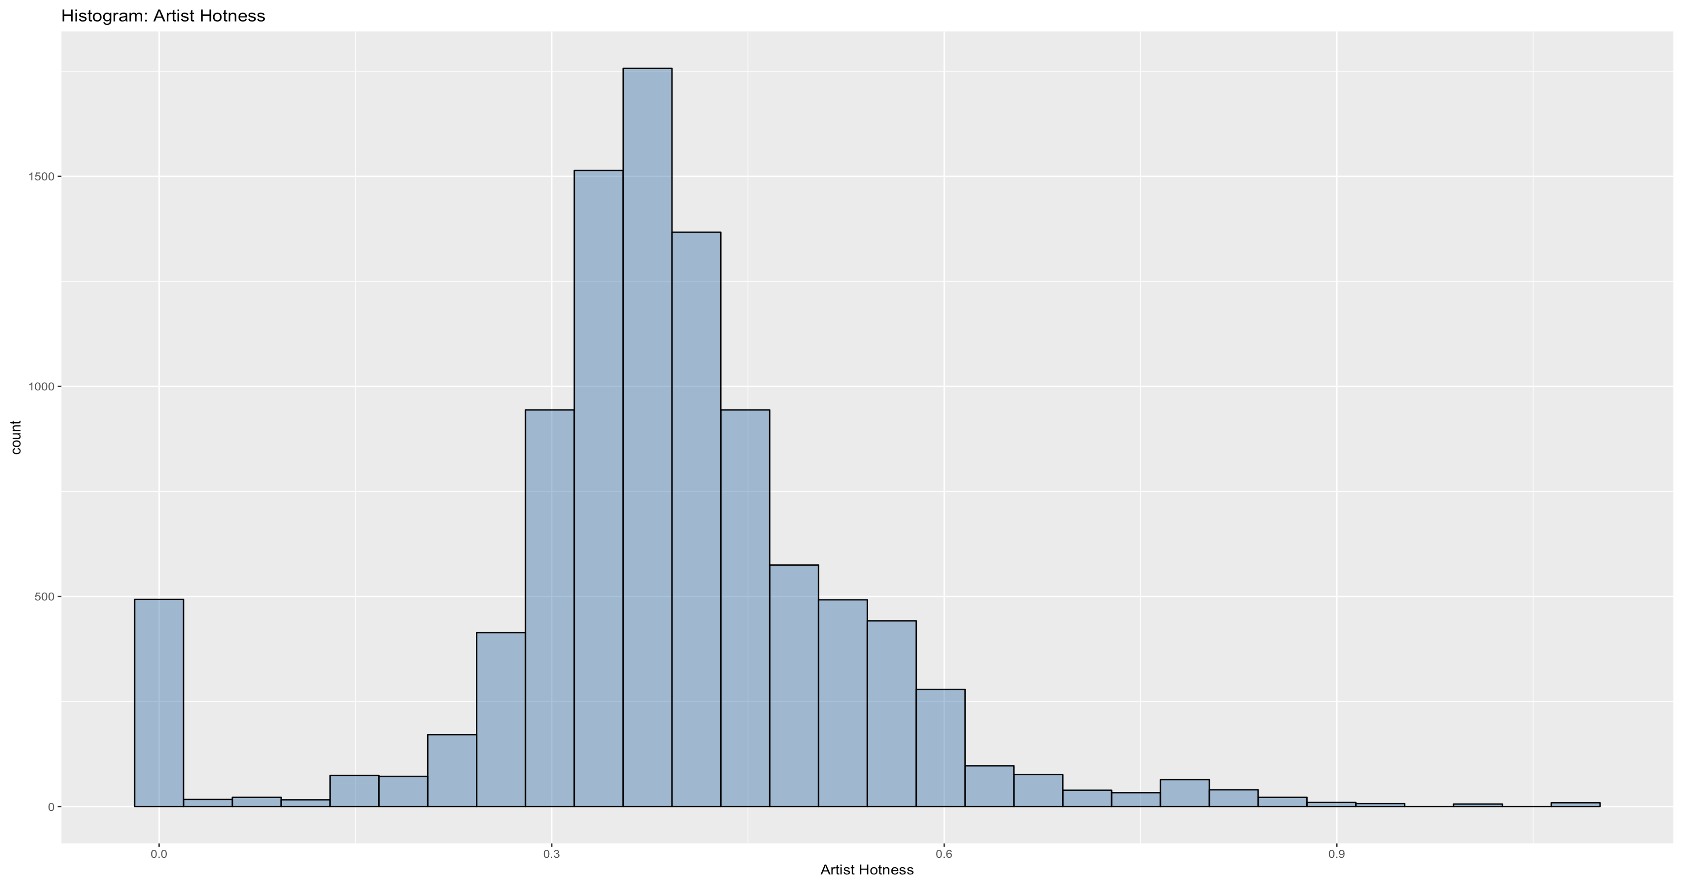
Artist hotness

Slide 20
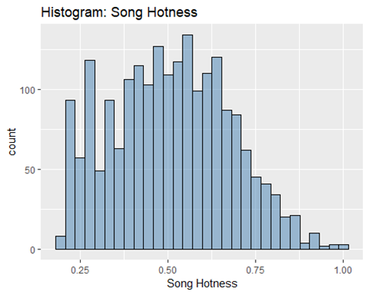
Song hotness

Slide 21
Artist hotness hot – warm - cold
Call:
randomForest(x = music[, -21:-22], y = music[, 21])
Type of random forest: classification
Number of trees: 500
No. of variables tried at each split: 4
OOB estimate of error rate: 20.18%
Confusion matrix:
 | COLD | HOT | WARM | class.error
COLD | 728 | 4 | 448 | 0.3830508
HOT | 6 | 1298 | 284 | 0.1836605
WARM | 200 | 198 | 2491 | 0.1377639

Slide 22
Song hotness hot – warm - cold
Call:
randomForest(cmbomusic5[,-13:-14],cmbomusic5[,14])
Type of random forest: classification
Number of trees: 500
No. of variables tried at each split: 3
OOB estimate of error rate: 46.49%
Confusion matrix:
 | COLD | HOT | WARM | class.error
COLD | 392 | 22 | 293 | 0.3830508
HOT | 44 | 169 | 233 | 0.1836605
WARM | 248 | 107 | 535 | 0.1377639

Slide 23
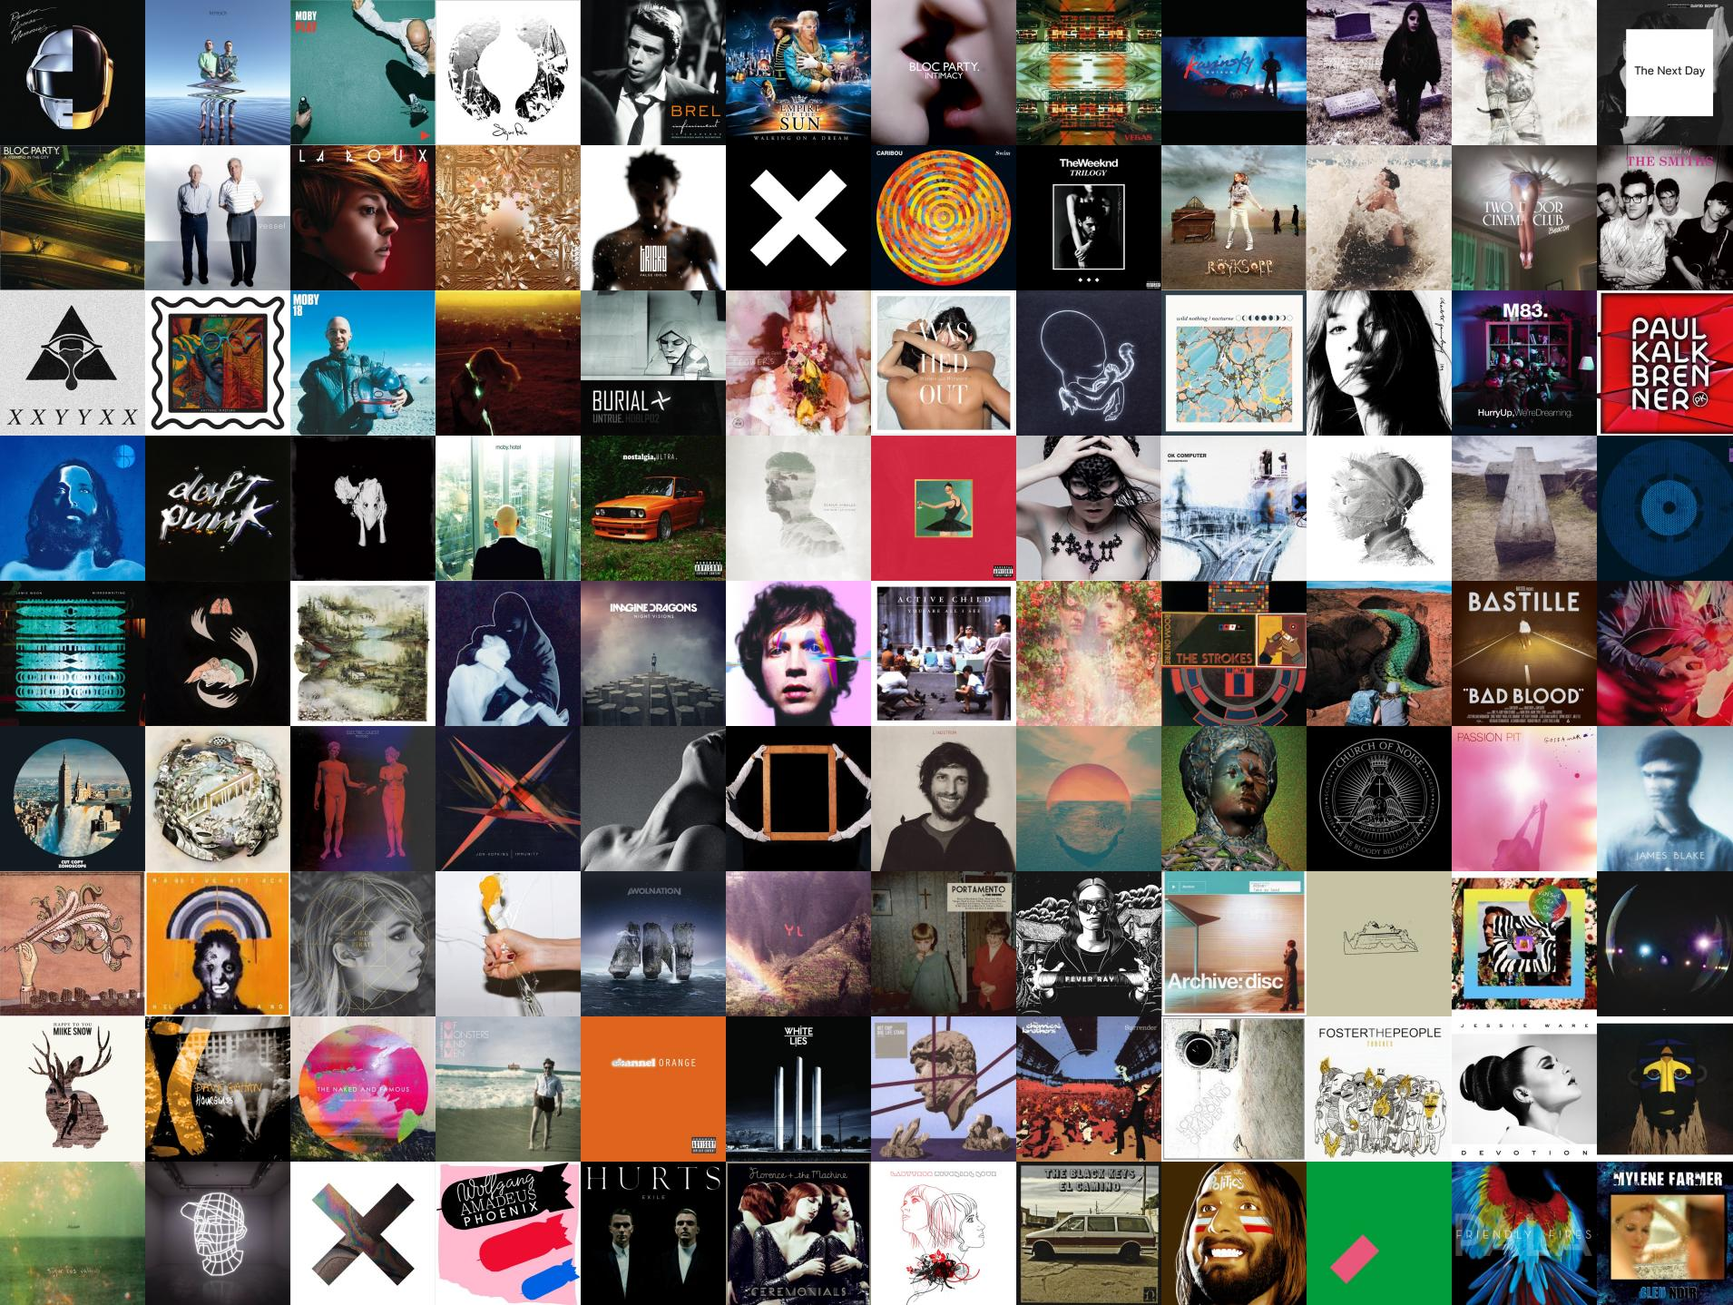
Notes:
We are looking at all sorts of songs and artist

